Slide 1
Statistical methods for electronic health record data American Causal Inference Conference
Jennifer F Bobb, R Yates Coley, Susan M Shortreed
Biostatistics Unit, Kaiser Permanente Washington Health Research Institute (KPWHRI)
jennifer.f.bobb@kp.org, rebecca.y.coley@kp.org, susan.m.shortreed@kp.org
Acknowledgements to entire Biostatistics Unit at KPWHRI
Notes:
Focus on design and analysis, not focusing on code

Slide 2
Welcome!
EHR data curation
Statistical methods for electronic health record data
Focus on design and analysis of studies using EHR data
Yates Coley (they/them/theirs)
PhD in Biostatistics from University of Washington, 2014
Methods expertise in prediction modeling and learning health systems science
Collaborations in aging, mental health, cancer, and health services research
Susan (she/her/hers)
Jennifer (she/her/hers)
PhD in Biostatistics from Johns Hopkins (2012) followed by postdoc at Harvard Biostat
Previous focus environmental health; current work with addiction research group at KPWHRI
How can health care systems best implement interventions addressing alcohol and other substance use disorders, particularly in primary care; methods to improve design/inference

Slide 3
Kaiser Permanente Washington Health Research Institute, Seattle, WA
EHR data curation
Kaiser Permanente Washington Health Research Institute
Formerly Group Health Research Institute, Group health was acquired by KP more recently
Research Institute began in the 1980’s
Strong connection to our KPWA members, each KP region has a research institute
65 faculty members across a variety of scientific areas
Aging, behavior and mental health, cancer prevention, health equity, pharmacoepidemiology
Biostatistics Unit: 10 PhD Investigators; 11 PhD and MS collaborative biostatistician analysts
KPWHRI is a member of several national research networks
Vaccine Safety Data link, Cancer Research Network, Health Care Systems Research Network, Mental Health Research Network
Strong collaborative relationship with University of Washington, Fred Hutchinson Cancer Research Center, and Veterans Affairs
Majority of our funding comes from NIH, PCORI, FDA, CDC
Additionally, have a learning health care system portfolio where KPWHRI investigators partner with KPWA leadership to address health system questions

Slide 4
Course Outline
EHR data curation
Introduction to electronic health records (EHR) data for research purposes
Break
Observational studies
Break
Pragmatic clinical trials
Discussion
Questions encouraged throughout!
Notes:
Note: we have tried to include a lot of examples of studies we have been involved with through out.
Susan presenting data curation; JBobb monitor chat for questions
JBobb presenting Prag trials; Yates monitor chat for questions
Susan presenting obs studies; JBobb monitor for chat
Yates prediction; Susan monitoring the chat

Slide 5
Introduction to electronic health records for research purpose

Slide 6
What is EHR data?
EHR data curation
Electronic health record (EHR) data is data generated in the process of health care delivery
EHRs initially developed for health care providers and insurers to manage healthcare billing (not to improve patient care)
EHR adoption incentivized by 2009 HITECH Act for health care providers
Two main sources of EHR data
Clinical records, also known as electronic medical record (EMR)
Health insurance claims data, also known as administrative claims
Notes:
included in the American Recovery Act of 2009
Draw distinction here between health care provider and health insurance provider

Slide 7
Health insurance, administrative claims data
EHR data curation
Generated when insurance billed for health-related services
Includes information necessary for insurance claim
Diagnosis codes- International classification of disease (ICD) v9/10
Encounter of procedure codes- current procedural terminology (CPT)
Pharmacy fills for medications or supplies
(Almost) all care observed, but not very much detail
No information on severity of illness, lab results, vital signs, etc.
Linked to particular health care coverage
Includes any paid services for health insurance enrollees while they are covered
Some claims data sources available to researchers for purchase
Centers for Medicare and Medicaid Services (CMS)
Optum
Notes:
Draw distinction here between health care provider and health insurance provider

Slide 8
Clinical, EMR data
EHR data curation
Generated when patient seeks health care with a particular provider
Rich source of information on all clinical care provided
Clinic visits/encounters, diagnoses, procedures (as in claims data)
Laboratory results, vital signs, imaging (not in claims data)
Pharmacy orders (vs. fills)
Structured text and embedded questionnaires, patient-reported outcomes (PROs)
Clinical notes, unstructured text
Linked to a health system
Includes care provided in that health system (regardless of insurance coverage)
Care documented may be affected by health insurance reimbursement
Does not include care given outside of that health system
Notes:
Certain CPT codes are reimbursed, while others aren’t, may affect what providers take the time to enter into record

Slide 9
EHR data sources
EHR data curation
Data Source | Strengths | Weaknesses
Claims data | Easily defined patient population Follow care for a patient across providers Includes medication fills Includes mortality status, (near) dates of death | Doesn’t include details of care provided not associated with billing Delay in data availability due to claims processing
Clinical data | Data availability doesn’t depend on insurance coverage Data available in (near) real time | Doesn’t include care provided outside the health system Challenging to define a patient population Includes orders for medications, not fills Only includes deaths that occur at health system facilities
Notes:
(Near) real time because some EHRs sync across providers or clinics in a health system daily

Slide 10
EHR data are extensive and complex!
Notes:
Example of data architecture that includes both claims and clinical data, shows…

Slide 11
Why do research with EHR data?
EHR data curation
Sample: Larger, more representative sample that one could easily (or affordably) obtain in a traditional study
Individual patient consent typically not required, but human subjects review still is!
More likely to include people of color, people who are not fluent in English, lower income patients
More detailed comprehensive information on a patient’s healthcare than you could easily (or affordably) obtain in a study
With large health systems or claims data, information across specialties and providers
Patient history not susceptible to recall bias
More complete, longer term capture of outcomes of interest (vs. relying on study visits)
Structured data elements easily translated into quantitative inputs for analysis (e.g., presence of absence of exposure or event of interest)
Notes:
EHR studies are not a way around HSR review, will not preclude patient consent in experimental studies
Counterpoint to representativeness: patients with access to receiving care will be unrepresented, EHR data reflects care RECEIVED not care NEEDED
Cost determined by the number of EHRs to access and combine, the complexity of data

Slide 12
Why do research with EHR data?
EHR data curation
EHR data can be used to supplement traditional research studies
Example: NIA-funded longitudinal Adult Changes in Thought (ACT) cohort
In depth data collected biennially in cohort at in-person examinations and surveys
Linked to administrative data for rich studies on aging
For example, gold standard dementia assessment in 2022 can be associated with medication fills over prior decades
EHR data can be used to assess generalizability of research findings
Notes:
EHR studies are not a way around HSR review, will not preclude patient consent in experimental studies
Counterpoint to representativeness: patients with access to receiving care will be unrepresented, EHR data reflects care RECEIVED not care NEEDED
Cost determined by the number of EHRs to access and combine, the complexity of data

Slide 13
Challenges of research with EHR data
EHR data curation
Selection bias
Measurement error, misclassification, and missing data
Multilevel data
Multi-site studies, Interoperability
Unstructured, free text data
Notes:
Overarching statistical concerns that influence all types of studies, including observational analyses, trials, and prediction

Slide 14
Selection bias in defining study sample
EHR data curation
Insurance claims data limited to those covered by a particular insurance plan to define a population of patients for whom health utilization is completely observed
Eligibility criteria likely includes some minimum length of prior enrollment
Must balance selection bias with measurement error
Clinical data studies in a health system must define population of patients for whom we expect to see most relevant care
Eligibility criteria typically based on prior utilization
Health equity- patients who have the most barriers to care are less likely to have continuous insurance coverage, consistent care with the same providers; studies with EHR data will exclude these patients

Slide 15
Measurement error, misclassification, and missing data
EHR data curation
Will affect both covariates and outcomes
Sources of measurement error/misclassification
Manually entered data may be incorrectly/imprecisely entered
Exacerbated by smart/predictive text or listing order for diagnosis codes
Lab values may have the wrong units indicated
Misdiagnosis
Overlap between measurement error/misclassification and missing data:
If a “true” diagnosis doesn’t appear in the chart- provider may have incorrectly ruled it out or not assessed the patient for it
Lack of prior enrollment or seeking care externally may cause missing, mismeasured data
More straightforward to think of predictors from the EHR as, e.g., “diagnosis of X indicated in the medical record” instead of “patient has X condition”
Health equity: EHR data reflects care received, not care needed. Populations with barriers to health care are less likely to have clinical needs accurately reflected in EHR data
Notes:
I want to work on this slide more, interplay between measurement error and missing data

Slide 16
Multilevel data
EHR data curation
Data are clustered within health system, clinic, provider, and patient
Clustering may be non-nested, e.g., if a patient sees multiple providers
Cluster size may be informative
People who are more sick have more encounters with health system (exacerbated in EHR data vs. studies with scheduled visits)
Health equity: cluster size may also be associated with access to affordable, effective, and culturally competent care.
Marginal models for longitudinal data (including GEE) assume cluster size is non-informative, estimates average effect for average observation (not average effect for average observation in average cluster)
Notes:
(Miglioretti and Healgerty, 2005 and 2006)

Slide 17
Multi-site studies, Interoperability
EHR data curation
Multi-site studies with EHR data can increase sample size, generalizability but pose many administrative, programming, and statistical challenges
Administrative- Data use agreements, secure data transfer
Programming- Interoperability
“If you’ve seen one EHR, you’ve seen one EHR”
Research networks with shared data models (e.g., PCORnet) facilitate data sharing
Health equity: Well-resourced health systems are more likely to have data infrastructure to support EHR studies, less likely to include safety net clinics (exception, OCHIN)
Statistical- Comparability
Clinical documentation practices vary across site
Measurement error and missing data patterns may also vary
Notes:
Clinical documentation practices example- problem list vs. assigning dx at each encounter; self-harm codes for suicide risk; completion of PHQ-9

Slide 18
Health system variability in recording depression symptoms
EHR data curation

Slide 19
Variation in data capture of injury intent across time
EHR data curation
Lu CY et al. (2014) How complete are E-codes in commercial plan claims databases? Pharmacoepidemiology and Drug Safety. 23:218-20

Slide 20
Unstructured, free text data
EHR data curation
Many important factors are recorded in unstructured, clinical text data
Symptoms, family and patient history, diagnoses ruled out,
Chart review and Natural Language Processing (NLP) can be used to derive structured variables from EHR
Chart review
Structured EHR variables can inform selection for chart review sample
Two-phase sampling can be used to supplement structured data
Chart review can be used to elicit misclassification rates for structured variables
NLP can identify patterns in free text and map to structured variables
E.g., “Patient’s mother had breast cancer” indicates family history
NLP and chart review can be used together
NLP identifies charts for chart review (e.g., any note that includes a particular word stem)
Chart review can validate accuracy of NLP model
Notes:
Clinical documentation practices example- problem list vs. assigning dx at each encounter; self-harm codes for suicide risk; completion of PHQ-9

Slide 21
Operationalizing clinical data for research
EHR data curation
Having clinical research partners is essential
Important to understand how data are coded in a particular health system
Know underlying variables of interest before developing organizational definitions
Pharmacy data: EHR contains pharmacy orders and claims data contain pharmacy fills
Intervention to change physician behavior: use pharmacy orders
Identify individuals taking a particular medication: use pharmacy fills (picked up scripts)
Know limitations of different data sources, for example: mortality
EHR only contains death happening in health care setting
Most people do not die in a health care setting
Health insurance companies can often determine death date but not cause of death
National death index covers the whole country but is quite delayed
State death records are generally for people who die in the state
Notes:
Can mention in presentation- type of study you are interested in will dictate what data you want to use, if EHR data is appropriate

Slide 22
Using clinical data to conduct observational studies
Susan M Shortreed, Biostatistics Unit KPWHRI

Slide 23
Outline - observational studies using clinical data
EHR data curation
Retrospective cohort
Common “types” of bias and approaches to address bias in clinical data base studies
Treatment selection bias: differences between those observed to receive treatments
Unmeasured confounding: don’t have something you wish you had!
Indication bias: certain people have really low (or zero) probability of treatment or outcome
Selection bias: who is in your sample and who is not
Measurement error: data you have may not accurately reflect the data you want
Informative observation times: Missing data is the complement of observed data

Slide 24
Retrospective cohort design
EHR data curation
Use clinical data from visits days or years in the past
Retrospective because data already collected
Always several threats to validity in an observational study, can address these threats by
Design: selecting the sample, control group, outcome and covariate definitions carefully
Analytic: use math to address bias: e.g. weighted regression, outcome model adjustment
Sensitivity analyses: assess robustness of results to design and analytic decisions
How do things change if different decision had been made?
If an assumption is not valid, how different would things be?
Use all three approaches!
There will always be limitations – be honest about what they are!
Just because data already collected doesn’t mean you should keep changing your study design
Think just as carefully about study design as you would for a prospective study

Slide 25
Retrospective cohort design
EHR data curation
Uses clinical data from visits days or years in the past
No matter study type or data source, always several threats to validity.
Can address (or minimize impact of) these threats by
Design: carefully select – study sample, comparison group, outcome and covariate definitions,
Analytic: use math to address bias - e.g. weighted regression, outcome model adjustment
Sensitivity analyses: assess robustness of results to design and analytic decisions
How do things change if different decision had been made?
If an assumption is not valid, how different would things be?
Use all three approaches!
There will always be limitations – be honest about what they are!
Just because data already collected doesn’t mean you should keep changing your study design
Think just as carefully about study design as you would for a prospective study

Slide 26
Designing a retrospective cohort
EHR data curation
Important to emulate a prospective study when designing a retrospective cohort study
Define eligibility at one point in time
Baseline covariates defined before or at this point
Start assessing exposure at time of eligibility
Assess outcome information going “forward” in time
Do you have accurate (and equal) outcome ascertainment on entire cohort?
Treat missing covariate and outcome information as missing data not as cohort exclusion criteria
Whenever possible… (example exception on the next slide)
Approaches discussed in Hernan et al. valuable when designing retrospective cohort studies
Hernán MA, Robins JM. Using Big Data to Emulate a Target Trial When a Randomized Trial Is Not Available. Am J Epidemiol. 2016;183(8):758-764. doi:10.1093/aje/kwv254

Slide 27
Compare mom and baby outcomes of antihypertensive medications
Retrospective cohort study of pregnant people with hypertension
Northern California, Southern California, and Washington regions of Kaiser Permanente
Hypertension defined using diagnosis codes, medication fills, and blood pressures (BPs)
Prior studies used claims only; did not have BP values, pre-pregnancy weight, or expected due date
Pregnancy is difficult to identify using EHR or claims data
Identified people who gave birth (live or stillbirth) and people who had termination after 20 weeks
Did not capture miscarriages or early terminations
Compared labetalol (n=3017), methyldopa (1834), nifedipine (1105), and other beta-blockers (390)
Small for gestational age; preterm delivery; NICU admission; preeclampsia; stillbirth, maternal ICU
Inverse probability of treatment weights to account for confounding
Adjusted prevalence for many outcomes similar across medication groups
Methyldopa had a lower rate of babies who were small for gestational age

Slide 28
Outline - observational studies using clinical data
Retrospective cohort
Common “types” of bias and approaches to address bias in clinical data base studies
Treatment selection bias: differences between those observed to receive treatments
Unmeasured confounding: don’t have something you wish you had!
Indication bias: certain people have really low (or zero) probability of treatment or outcome
Selection bias: who is in your sample and who is not
Measurement error: data you have may not accurately reflect the data you want
Informative observation times: Missing data is the complement of observed data

Slide 29
Addressing treatment selection bias (i.e. non-randomized treatment bias)
Treatment selection bias (confounding): bias in treatment effect because of who was exposed to treatment compared to who was not
Design: select comparator group that is similar to intervention group (except the exposure)
Definition of comparator groups affected by is included in cohort
Collaborating with scientific partners essential
Two main types of comparator groups: concurrent and historical
Can use more than one comparator group!
Analytic: Use analytic methods to account for bias due to differences in who was observed to have the treatment and who was observed to be in the comparator group
Sensitivity analyses: how far off could we have been?
Design: Pick a primary comparison, redo analysis under different decisions, are they different?
Focus on point estimates not confidence intervals
Analytic: A few different unmeasured confounding sensitivity analyses
Health equity: given equal access to care, not everyone receives equal access to treatment

Slide 30
Treatment selection bias
Many methods advancement in recent years for addressing treatment selection bias
Propensity score methods among the most popular, especially in EHR data
EHR data can provide many, many covariates to adjust for in analyses
Propensity score (PS) is a summary measure: P(treatment | X)
Can help protect patient privacy, by sharing propensity score rather than all covariates.
Popular ways to use propensity score to adjust for confounding: inverse probably weights, matching, outcome adjustment (must use flexible models), stratification
Everything but weighting, can be done directly with covariates (i.e. not propensity score)
Selecting which covariates to include in propensity score is important
Which variable included affects bias and statistical efficiency (i.e. big standard errors)
We use both propensity score methods and non-propensity score methods
In rare outcome settings may not have degrees of freedom for outcome adjustment
Notes:
3 examples
1. NTD defect, rare outcome wanted to do matching did propensity score weighting [JB: our initial plan was to do adjustment, but couldn’t due to rare outcome]
2. long-term opioid therapy, historical and concurrent control
3. Bariatric surgery matching example.

Slide 31
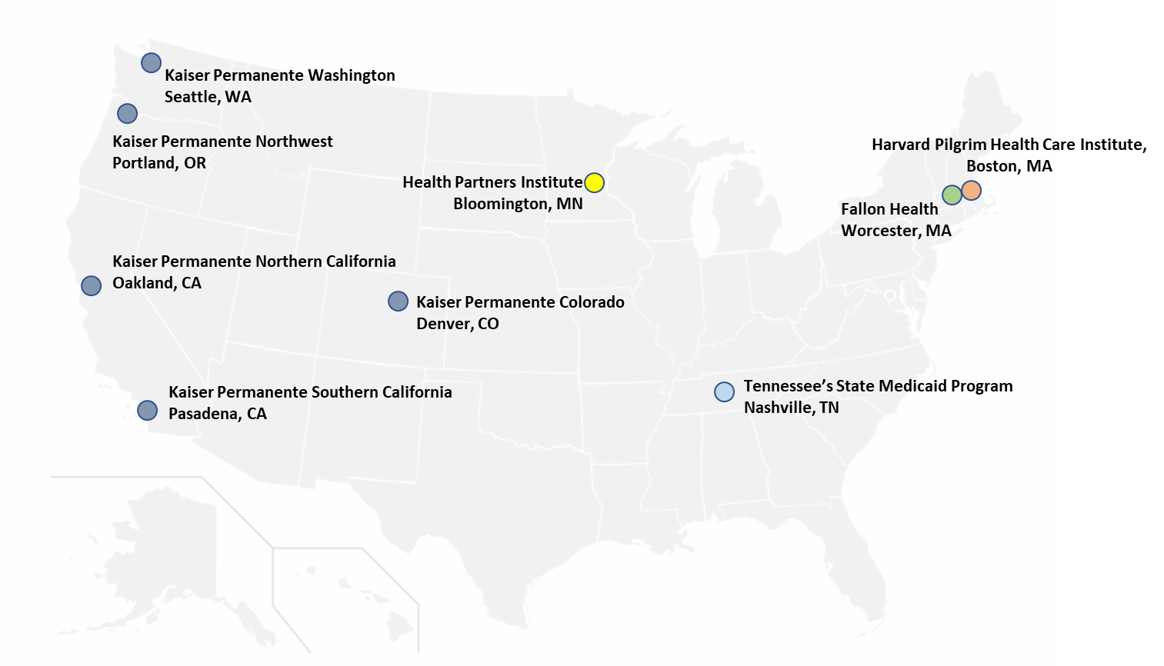
Early pregnancy exposure to opioids and neural tube defects (NTDs)
Health plan administrative data linked to birth certificate data, as part of the Medication Exposure in Pregnancy Risk Evaluation Program (MEPREP)
Potential NTD outcomes identified via ICD codes and then validated by clinical experts
People who have been using opioids long term too different from those not taking opioids?
New user design:
925,533 eligible mom/baby pairs
19,072 pregnancies with “new” dispensing for opioid during critical exposure period (2.1%)
1:3 matched (maternal age, site)
57,219 unexposed pregnancies

Slide 32
Early pregnancy exposure to opioids and neural tube defects (NTDs)
Ultra rare outcome:
Primary NTDs: just 11 cases in matched cohort
Limited ability to adjust for potential confounders in outcome regression
Approach to address treatment selection bias:
Estimated propensity score using logistic regression
Inverse probability of treatment weighting (IPTW)
Used weights for “average treatment effect among the treated” (ATT)
Weighted logistic regression to estimate odds ratios
Results of primary analysis non-statistically significant
Odds ratio 3.0 (95% CI: 0.7, 12.7)
Covariates included in the propensity score | Categories of covariate
Site | each site (9 total)
Maternal age | 15-19, 20-24, 25-29, 30-34, 35-39, 40-49
Calendar year of delivery | each year of study (14 total)
Maternal race/ethnicity | Hispanic, White, Asian, Black, other
Maternal education | ≤ 12 years, > 12 years
Medicaid insurance | yes, no
Pre-gestational diabetes | yes, no
Parity | nulliparous, parous
Nitrosatable medication use during pregnancy | yes, no
Alcohol use disorder | yes, no

Slide 33
Bariatric surgery and macrovascular disease
Scientific question: Does getting bariatric surgery reduce risk of macrovascular disease in patients with Type 2 diabetes and severe obesity compared to non-surgical treatment?
Challenge: Only a very small proportion of patients eligible for bariatric surgery choose surgery and there is not a single decision point - patients’ eligibility is time varying
5,301 patients aged 19-79 years with BMI >= 35, type 2 diabetes who had surgery between 2005 & 2011 matched to >320k non-surgical patients (aged 19-79 years with BMI >= 35, type 2 diabetes)
Matched on: site; age (+/- 10 years), BMI (+/- 5), HbA1c (+/- 1.5%); insulin use status
Among eligible matched sets used Mahalanobis distance to match each surgical patient to up to 3 non-surgical patients (without replacement)
Mahalanobis distance calculated using age, BMI, HbA1c, diabetes duration, and number of days of health care utilization in the 7 through 24 months prior to surgery
Lower risk of macrovascular disease for patients with bariatric surgery, HR=0.60 (95% CI: 0.42-0.86)
Fisher DP, Johnson E, Haneuse S, Arterburn D, Coleman KJ, O'Connor PJ, O'Brien R, Bogart A, Theis MK, Anau J, Schroeder EB, Sidney S. Association Between Bariatric Surgery and Macrovascular Disease Outcomes in Patients With Type 2 Diabetes and Severe Obesity. JAMA. 2018 Oct 16;320(15):1570-1582. doi: 10.1001/jama.2018.14619.
Notes:
Mahalanobis distance takes into account correlation between the matching variable.
Fisher et al. (2018) JAMA

Slide 34
Interrupted time series – a type of historical control
Concurrent control is most common comparison group
Historical controls can be confounded by time
Can use both concurrent and historical control in same study!
Use concurrent control to account for changes over time unrelated to intervention
Think carefully in selecting concurrent control group
Adjust for potential confounders
Use regression “discontinuity” approaches to model changes over time
Potential inflection points when interventions begin (or expected effect of)
Smooth or non-smooth changes
Health systems are usually giant ships and tend not to change on a dime
But EHR based interventions can be turned on with flip of a switch!

Slide 35
Did risk reduction initiative for patients on long-term opioid therapy reduce motor vehicle crashes?
Used regression discontinuity to assess impact of interventions on motor vehicle crashes
Jan 1 2008: intervention to alter prescribing behavior
Sept 30 2010: multifaceted risk reduction intervention
Created rolling (quarterly) entry retrospective cohort study using EHR data 2006 thru 2014
Identified people on long-term opioid therapy (LTOT) in each quarter of study period
Jan 1, 2006, April 1 2006, July 1 2006, …, April 1 2014, July 1 2014
Individuals classified as on long-term opioid therapy if in last 90 days patient had at least 70 days supply of opioids on hand
Some people in cohort entire study period, some only in for one quarter
Assessed if motor vehicle crash occurred in 90 days following beginning of quarter
Linked state motor vehicle crash registry to EHR data
Concurrent control group: patients using LTOT seeing Group Health’s contracted providers
Intervention only provided to Group Health clinicians
Notes:
Hansen, R. N., et al. (2017). "Impact of an opioid risk reduction initiative on motor vehicle crash risk among chronic opioid therapy patients." Pharmacoepidemiol Drug Saf 26(1): 47-55.

Slide 36
Motor vehicle crashes over time in long-term opioid therapy patients
Hansen RN, Walker RL, Shortreed SM, Dublin S, Saunders K, Ludman EJ, Von Korff M. Impact of an opioid risk reduction initiative on motor vehicle crash risk among chronic opioid therapy patients. Pharmacoepidemiol Drug Saf. 2017 Jan;26(1):47-55. doi: 10.1002/pds.4130. Epub 2016 Nov 14. PMID: 27862597.
Notes:
Mention rural/urban difference

Slide 37
Unmeasured confounding
Design: Select study sample and comparator to reduce unobserved confounding!
Two-phase sampling collects more data on subset of observations (usually covariates that are expensive to collect)
Can stratify sampling of subset for additional data collection (e.g., on exposure or outcome)
Can link to external data or conduct additional data collection to augment what is available in EHR
Analytic: Use analytic methods that aim to adjust for unobserved confounding
Instrumental variable (IV) analysis: IV only associated with outcome through exposure (can be hard to assess!)
Randomized treatment arm is ideal instrumental variable
Geographic proximity or provider preference are common IVs in clinical research

Slide 38
Unmeasured confounding
Sensitivity analysis: Evaluate how sensitive effect estimates are to unobserved confounding
E-value: minimum association b/w unmeasured confounder and outcome needed to “explain away” estimated effect.
Larger E-value means effect estimate less likely due to unobserved confounding
Negative control: evaluate whether exposure has estimated impact on unrelated outcome
Can be helpful to assess if treatment appears protective because those with treatment are healthier
Alternatively, can evaluate whether exposure at unrelated time impacts outcome
Health equity: Clinical data rarely contains data on social determinants of health in a comprehensive way

Slide 39
Unmeasured confounding sensitivity analyses: bariatric surgery and macrovascular disease
Scientific question: Does bariatric surgery reduce risk of macrovascular disease in patients with Type 2 diabetes and severe obesity compared to non-surgical treatment?
Challenge: People who choose to have surgery are likely different than those who do not, and those differences may not be captured in the EHR
Primary analysis found lower risk of macrovascular disease for patients with bariatric surgery, hazard ratio=0.60 (95% CI: 0.42-0.86)
E-value analysis done as a sensitivity analysis
Unobserved confounder would need to have a relative risk of 2.72 to overcome observed association (hazard ratio=0.60) between surgery and macrovascular disease
Conducted E-value calculations for upper bound of confidence interval
A relative risk of 1.6 would be needed to overcome an association of HR=0.86
Fisher DP, Johnson E, Haneuse S, Arterburn D, Coleman KJ, O'Connor PJ, O'Brien R, Bogart A, Theis MK, Anau J, Schroeder EB, Sidney S. Association Between Bariatric Surgery and Macrovascular Disease Outcomes in Patients With Type 2 Diabetes and Severe Obesity. JAMA. 2018 Oct 16;320(15):1570-1582. doi: 10.1001/jama.2018.14619.
Notes:
Conducted E-value calculations for upper bound of confidence interval
How strong would an unmeasured confounders association have to be to move that bound up to include 1.

Slide 40
Estimating effect of flu vaccine on mortality
Studies have shown seniors who receive a flu vaccine are at greatly reduced risk of hospitalization for pneumonia and for all-cause mortality during flu season
But estimated effect is very large (relative risk ~50% of all-cause mortality)
Are true effects of vaccination more modest?
Were previous studies affected by unobserved confounding?
Negative control: most people get flu vaccine in fall, but flu doesn’t circulate until winter!
Association with spurious outcomes, means lower estimated risk likely due to unobserved confounding, i.e. those who receive flu vaccine are healthier in ways that weren’t measured
Those who receive flu vaccine had decreased risk of death
before flu season relative risk = 0.36 and after flu season relative risk = 0.76 compared to relative risk = 0.56 during flu season
Recent methods advancements to formally integrate negative control into effect estimate
Jackson ML, Yu O, Nelson JC, Naleway A, Belongia EA, Baxter R, Narwaney K, Jacobsen SJ, Shay DK, Jackson LA. Further evidence for bias in observational studies of influenza vaccine effectiveness: the 2009 influenza A(H1N1) pandemic. Am J Epidemiol. 2013 Oct 15;178(8):1327-36. doi: 10.1093/aje/kwt124. Epub 2013 Aug 26. PMID: 23978527; PMCID: PMC7314269.

Slide 41
Indication bias
An extreme case of treatment selection bias
Happens when most of control group may not be eligible for treatment
If control group has very different outcomes, then could lead to biased estimates of treatment effect
Some approaches to address indication bias (design and sensitivity analyses)
Smart comparator group definition
Always think carefully about the comparator group
Restrict to only those with the indication for the medication
Rarely can get clear indication from actual medication prescription, but can approximate in other ways
Self-control approach (historical comparison approach)
Need short follow-up time for this study design to work
Health equity: given equal access to care and symptoms, not everyone receives same diagnosis

Slide 42
ACEIs and ARBs do not increase risk of COVID19 infection
Angiotensin-converting enzyme inhibitors (ACEIs) and angiotensin receptor blockers (ARBs)
Early on concern these drugs could increase risk of COVID infection
Some patients were discontinuing ACEI and ARB use
Indications for use: hypertension, diabetes, congestive heart failure, history of heart attack
Cohort: Kaiser Permanente Washington members 18 years of age or older on Feb 29, 2020
Compared patients who filled ACEI or ARB prescription in prior 4 months to those with no fills
56,105 ACEI/ARB users and 265,939 non-users: adjusted odds ratio (aOR) 0.91 (0.74, 1.12)
Analytically controlled for: age, sex, race and ethnicity, diabetes, hypertension, congestive heart failure, history of heart attack, Charlson co-morbidity index, asthma, chronic obstructive pulmonary disease, body mass index, smoking, renal disease, insulin, prednisone, malignant cancer
May still be differences between ACEI/ARB users and non-users
Sensitivity analyses limited to patients who had an indication for ACEI/ARb use
46,907 ACEI/ARB users and 33,359 non-users: aOR 0.83 (0.66, 1.05)
Dublin S, Walker RL, Floyd JS, Shortreed SM, Fuller S, Albertson-Junkans L, Harrington LB, Greenwood-Hickman MA, Green BB, Psaty BM. Renin-Angiotensin-Aldosterone System Inhibitors and COVID-19 Infection or Hospitalization: A Cohort Study. Am J Hypertens. 2021 Apr 20;34(4):339-347.
Notes:
SMS: they increase expression of the receptor by which COVID (and other SARS viruses) gains entry into epithelial cells
Dublin, S., et al. (2020). "Renin-angiotensin-aldosterone system inhibitors and COVID-19 infection or hospitalization: a cohort study." medRxiv.
SMS: in this example not too worried about indication bias, so included it as a sensitivity analyses.

Slide 43
Antidepressant use in pregnancy and risk of gestational diabetes
Prior studies show an increased risk, but may be affected by confounding by indication
Depression is associated with adverse health outcomes
Women taking antidepressants may be at higher risk than those not taking antidepressants
Cohort: Kaiser Permanente Washington women with singleton birth between 2001 and 2004
Pregnancies associated with more than one baby at higher risk for gestational diabetes
Restricted cohort to women taking antidepressant prior to pregnancy
More than one antidepressant fill at least 6 months prior to pregnancy
Women with antidepressant fill during pregnancy referred to as continuers (n=1634)
Comparison group: those with no fills during pregnancy (n=1211, discontinuers)
Used inverse probability of treatment weights to control for confounding
Relative risk comparing continuers to discontinuers: 1.10 95% CI: (0.84,1.44)
Wartko PD, Weiss NS, Enquobahrie DA, Chan KCG, Stephenson-Famy A, Mueller BA, Dublin S. Antidepressant continuation in pregnancy and risk of gestational diabetes. Pharmacoepidemiol Drug Saf. 2019 Sep;28(9):1194-1203. doi: 10.1002/pds.4799. Epub 2019 Jul 12. PMID: 31298445; PMCID: PMC6728166.
Notes:
SMS: indication bias a big concern
Wartko, P. D., et al. (2019). "Antidepressant continuation in pregnancy and risk of gestational diabetes." Pharmacoepidemiol Drug Saf 28(9): 1194-1203.

Slide 44
Safety of sulfonamide antibacterials in pregnancy
Medication Exposure in Pregnancy Risk Evaluation Program (MEPREP)
Cohort: 1.2 million live-born births from 2001-2008 at 11 US health plans
Excluded mothers with exposure to meds known to cause birth defects
Mothers with first-trimester trimethoprim-sulfonamide (TMP-SUL) exposures matched 1 to 1 to
Primary comparison: mothers exposed to penicillin and/or cephalosporins
Secondary: mothers with no fills of an antibacterial, antiprotozoal or antimalarial medication
Matched on age (± 5 years) and health plan
Outcomes: cardiovascular abnormalities, cleft palate/lip, clubfoot, urinary tract abnormalities
6688 infants in each of the exposure groups (TMP-SUL, primary comparison, secondary comparison)
Primary comparison: TMP-SUL not associated with increase risk of any outcomes
Secondary comparison: all 95% confidence intervals include 1
Hansen C, Andrade SE, Freiman H, Dublin S, Haffenreffer K, Cooper WO, Cheetham TC, Toh S, Li DK, Raebel MA, Kuntz JL, Perrin N, Rosales AG, Carter S, Pawloski PA, Maloney EM, Graham DJ, Sahin L, Scott PE, Yap J, Davis R. Trimethoprim-sulfonamide use during the first trimester of pregnancy and the risk of congenital anomalies. Pharmacoepidemiol Drug Saf. 2016 Feb;25(2):170-8. doi: 10.1002/pds.3919. Epub 2015 Nov 24. PMID: 26599424; PMCID: PMC4772767.
Notes:
SMS: skip if it all feeling short on time!!!!!
Hansen, C., et al. (2016). "Trimethoprim-sulfonamide use during the first trimester of pregnancy and the risk of congenital anomalies." Pharmacoepidemiol Drug Saf 25(2): 170-178.
BACKGROUND: Sulfonamide antibacterials are widely used in pregnancy, but evidence about their safety is mixed. The objective of this study was to assess the association between first-trimester sulfonamide exposure and risk of specific congenital malformations. METHODS: Mother-infant pairs were selected from a cohort of 1.2 million live-born deliveries (2001-2008) at 11 US health plans comprising the Medication Exposure in Pregnancy Risk Evaluation Program. Mothers with first-trimester trimethoprim-sulfonamide (TMP-SUL) exposures were randomly matched 1:1 to (i) a primary comparison group (mothers exposed to penicillins and/or cephalosporins) and (ii) a secondary comparison group (mothers with no dispensing of an antibacterial, antiprotozoal, or antimalarial medication during the same time period). The outcomes were cardiovascular abnormalities, cleft palate/lip, clubfoot, and urinary tract abnormalities. RESULTS: We first identified 7615 infants in the TMP-SUL exposure group, of which 7595 (99%) were exposed to a combination of TMP-SUL and the remaining 1% to sulfonamides alone. After matching (1:1) to the comparator groups and only including those with complete data on covariates, there were 20 064 (n = 6688 per group) in the primary analyses. Overall, cardiovascular defects (1.52%) were the most common and cleft lip/palate (0.10%) the least common that were evaluated. Compared with penicillin/cephalosporin exposure, and no antibacterial exposure, TMP-SUL exposure was not associated with statistically significant elevated risks for cardiovascular, cleft lip/palate, clubfoot, or urinary system defects. CONCLUSIONS: First-trimester TMP-SUL exposure was not associated with a higher risk of the congenital anomalies studied, compared with exposure to penicillins and/or cephalosporins, or no exposure to antibacterials.

Slide 45
Selection bias – when using clinical data in general (recall)
Clinical data limits who is in your sample, must think carefully about generalizability of results
If using EHR data, only those seeking care in those clinics
If using claims data, only those seeking care and who have that insurance
There are many decisions along the way that impact who is in the study
Think about them carefully!
Being very restrictive can result in a “clean” population, but it also restricts power and limits generalizability
Think carefully about required specific diagnoses or exclusion criteria

Slide 46
Selection bias
Designing the cohort: who gets into your sample and how they get in is important
Retrospective studies can access (minimal) information on people who are not in main cohort
Can often assess who was excluded
Can do sensitivity analyses with different samples to assess robustness of results
Keep in mind scientific question and power when defining the sample
A factor in defining sample for observational studies come from requiring prior enrollment
Measurement error versus selection bias
No obvious choice in all scenarios, must remain focused on the scientific question
Analytic strategies can be used to assess and account for selection bias (by measured variables)
Selection bias always exists in research studies, can use EHR data to assess selection bias in traditional studies too.
One can do sensitivity analyses on defining population, but it can get thorny quickly.

Slide 47
Assessing impact of colorectal cancer screening
Screening colonoscopy is done infrequently, usually every 10 years
Want to have long histories of prior enrollment to assess if patients had colonoscopy in past
Length of prior enrollment may be associated with cancer risk and mortality
Group Health members aged 40 years and older as of Jan 1 2008
Exclude members with known cancer diagnosis on or before Dec 31 2007
Explored association between prior enrollment and 5-year risk of cancer & all-cause mortality.
Follow-up time censored at disenrollment from health system or on Dec 31, 2012
Three groups: Less than 5 years prior enrollment; 5 to 10 years; more than 10 years
Collected age, sex, race, tobacco use, Charlson comorbitiy, and body mass index
Individuals with longer prior enrollment tended to be older
Used weighted Kaplan Meier curves to account for age (and sex) in comparison
Shortreed SM, Johnson E, Rutter CM, Kaminei A, Wernli KJ, Chubak J. (2016) Cohort restriction based on prior enrollment: examining potential biases in estimating cancer and mortality risk. Observational Studies, 2:51-64

Slide 48
Accounting for non-response in the Middle-Aged/Seniors Chronic Opioid Therapy (MASCOT) survey.
Alternatively, can use EHR data to assess and account for non-response in surveys
Of 2489 people eligible and contacted, 1289 (51.8%) completed baseline interview
Assessed predictors of survey response
General patient characteristics: age, sex, race, ethnicity, Charlson
Opioid misuse risk factors: tobacco use, substance use disorders, mood/anxiety disorders, having excess opioids on hand due to early refills, receiving opioids from more than 3 prescribers, high opioid dose, co-prescribed sedative
Older people were more likely to respond: 51.7 % response rate for patients between 45 and 55 years old and 59.9% response rate for patients 75 years and older
Other than age very few things related to survey non-response!
Increased confidence in study results
(Similar analyses can also be used to assess generalizability of trial results)
Shortreed SM, Von Korff M, Thielke S, LeResche LA, Saunders KW, Rosenberg D, Turner JA. (2016) Electronic health records to evaluate and account for non-response bias: A survey of patients using chronic opioid therapy Observational Studies, 2:24-3

Slide 49
Some thoughts on measurement error in clinical data
Always need to think carefully about how data collected and potential for error
Absence of a diagnosis code does not mean the patient doesn’t have the disease
Stigmatized conditions (e.g., substance use disorders) are not always documented
Diagnosis and procedure codes can also have error (i.e., misclassification)
“Rule-out” diagnoses common in some conditions
Measuring medication exposure is tricky!
Medication orders: do not capture whether patient actually picked up prescription
Medication dispensings: do not capture whether patient actually took medicine
(Self-report also has its own difficulties: e.g. recall concerns, non-response)
Measurement error can occur anywhere: exposure, covariates and outcomes
Often all three!
Notes:
JB: I added this slide, but welcome any additional thoughts. In particular, I have not used formal methods to account for exposure/outcome misclassification (besides doing chart review to obtain a “validated” measure)
Some articles to cite:
Hubbard RA, Huang J, Harton J, Oganisian A, Choi G, Utidjian L, Eneli I, Bailey LC, Chen Y. A Bayesian latent class approach for EHR‐based phenotyping. Statistics in medicine. 2019 Jan 15;38(1):74-87.
van Walraven C. Bootstrap imputation with a disease probability model minimized bias from misclassification due to administrative database codes. Journal of Clinical Epidemiology. 2017 Apr 1;84:114-20.

Slide 50
Measurement error
Design
No study will be perfect
Design best you can; know when the question cannot be answered with data available
E.g., EHR data not a good source for over-the-counter medications
Validation studies to assess properties of measures (e.g., sensitivity, specificity) are key
Two-phase study designs can be used to efficiently combine error-prone data on full cohort, with more precise “gold standard” data on a subset
Analytic
Regression calibration approaches can be used to account for measurement error
Can use multiple imputation or complex algorithms to address measurement error
Sensitivity analyses
Exposure misclassification example: require two or more fills of medication to be exposed
Addresses folks picking up meds but not taking them
Health equity: less likely to have accurate information on people with short enrollment histories
Notes:
Some articles to cite:
Hubbard RA, Huang J, Harton J, Oganisian A, Choi G, Utidjian L, Eneli I, Bailey LC, Chen Y. A Bayesian latent class approach for EHR‐based phenotyping. Statistics in medicine. 2019 Jan 15;38(1):74-87.
van Walraven C. Bootstrap imputation with a disease probability model minimized bias from misclassification due to administrative database codes. Journal of Clinical Epidemiology. 2017 Apr 1;84:114-20.

Slide 51
Does statin use increase risk of community-acquired pneumonia?
Case-control study of community dwelling Group Health members 65 to 94 years old
Pneumonia cases confirmed through chart review
Two controls matched on age (±1 year), sex, calendar year, pneumonia free follow-up time
Index date defined as data of pneumonia for case and their matched controls
Exposure group: long-term statin use
Defined as at least two filled statin prescriptions in the 180 days prior to index date
181 pneumonia cases with statin exposure and 327 without statin exposure
944 pneumonia cases without statin exposure and 1908 without statin exposure
Minimally adjusted (i.e. just for matching variables) odds ratio 1.13, 95 CI: (0.95, 1.34)
Adjusting for comorbidities odds ratio 1.26 (1.01, 1.56)
Conducted many sensitivity analyses, all estimates hovered around 1 or a bit larger
Conclusion: no evidence that statin use protective against community acquired pneumonia
Dublin S, Jackson ML, Nelson JC, Weiss NS, Larson EB, Jackson LA. Statin use and risk of community acquired pneumonia in older people: population based case-control study. BMJ. 2009 Jun 16;338:b2137. doi: 10.1136/bmj.b2137. PMID: 19531550; PMCID: PMC2697311.
Notes:
Dublin, S., et al. (2009). "Statin use and risk of community acquired pneumonia in older people: population based case-control study." BMJ 338: b2137.

Slide 52
Two-phase study examining association between elective induction of labor and pregnancy outcomes
Exposure groups: Among women who were pregnant and had no indication of labor through week X of pregnancy (X = 38, 39, 40),
Electively induction (EI) of labor vs. “Expectant management” (i.e., pregnancy continues)
Measurement error: Challenging to define a “phenotype” of EI using automated data – requires absence of indications; pregnancy outcomes also error-prone
Two phase study design:
Phase 1: cohort of eligible pregnancies identified via electronic/automated data
Phase 2: stratified sample selected (oversampling those with apparent EI and outcomes)
Obtained “gold standard” measures of EI, mom and baby outcomes, and some confounders (e.g., smoking status)
Statistical analysis: semiparametric maximum likelihood to efficiently use all data while accounting for outcome-dependent sampling
Outcomes differed by gestational age: EI at 39 weeks was associated with cesarean delivery (prevalence 41% vs. 28%; OR 1.77 [1.14–2.81]).

Slide 53
Informative observation times
How often someone accesses health care is tied to many things
Health care coverage complicated (e.g. co-pays, deductibles, visit limits, referrals, etc)
Barriers to health care beyond financial (e.g., geographical location, cultural competency, etc)
“Sicker” patients tend to receive more care
Have more visits and more chances for other diagnoses and information recorded
Informative cluster size may have an impact on study results
Must think about this in addition to accounting for correlation
Informative observation times may impact studies addressing some scientific questions but not all
If modelling longitudinal trajectories, think carefully about when measurements occur
Especially if there are differences in visit patterns between comparison groups
Health equity: health systems and culturally sensitive care can impact follow-up care
Neuhaus, J. M., et al. (2018). Analysis of longitudinal data from outcome-dependent visit processes: Failure of proposed methods in realistic settings and potential improvements. Statistics in Medicine 37(29): 4457-4471.
Notes:
McCulloch, C. E., et al. (2016). "Biased and unbiased estimation in longitudinal studies with informative visit processes." Biometrics 72(4): 1315-1324.
Neuhaus, J. M., et al. (2018). "Analysis of longitudinal data from outcome-dependent visit processes: Failure of proposed methods in realistic settings and potential improvements." Statistics in Medicine 37(29): 4457-4471.

Slide 54
Does receipt of alcohol-related care differ for patients with HIV?
Veterans Health Administration (VA) implemented annual alcohol screening in 2004
Evidence-based brief interventions for unhealthy alcohol in 2007
Alcohol use disorders identification test consumption (AUDIT-C)
Validated measure of alcohol use, can be used to identify unhealthy alcohol use.
Goal: compare rates of brief intervention in 12 months following AUDIT-C for patients living with HIV and patients not living with HIV
Used data extracted from VA research data warehouse from 10/1/2009 through 5/30/2013
Identified all AUDIT-C with responses that indicated unhealthy alcohol use
Some individuals had one AUDIT-C a year; some had many AUDIT-C’s in a year
Primary analysis used multiple AUDIT-Cs per person (at least 9 months between AUDIT-C)
Adjusted relative risk=0.83 (0.80, 0.85)
Sensitivity analyses selected one AUDIT-C at random
Adjusted relative risk =0.86 (0.85, 0.88)
Williams, E. C., et al. (2017). Among patients with unhealthy alcohol use, those with HIV are less likely than those without to receive evidence-based alcohol-related care: A national VA study. Drug Alcohol Depend 174: 113-120.
Notes:
Williams, E. C., et al. (2017). "Among patients with unhealthy alcohol use, those with HIV are less likely than those without to receive evidence-based alcohol-related care: A national VA study." Drug Alcohol Depend 174: 113-120.

Slide 55
Estimating risk of suicide attempt following PHQ item 9 response
Patient health questionnaire item 9 asks about thoughts of death and harming yourself
Never (0); some of the time (1); More than half the days (2); most of the days (3)
PHQ used in Mental Health Research Network health systems to diagnosis & monitor depression
Behavioral health specialty all patients get PHQ when they walk in the door
People with more PHQ responses recorded in EHR seeking more mental health care
People who seek more mental health care at higher risk for suicide attempt.
Model: time to suicide attempt, fatal and non-fatal, from each PHQ item 9 response
Compare rates after visits with a response of 0 recorded
Traditional time-varying Cox model would censor follow-up time at new PHQ response
Informative censoring: Those who seek more mental health care censored more often
Partly conditional Cox model does not censor after data updates
Averages over what is observed to happen in the future in the data
Notes:
Zheng, Y. and P. J. Heagerty (2005). "Partly conditional survival models for longitudinal data." Biometrics 61(2): 379-391.

Slide 56
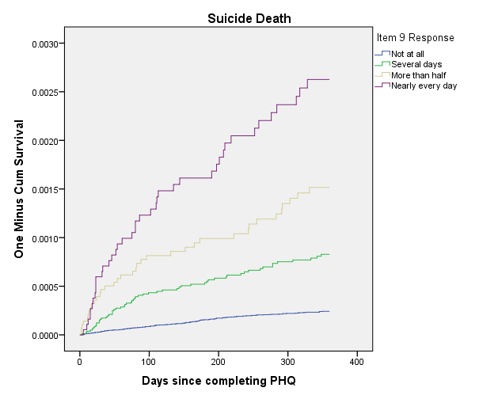
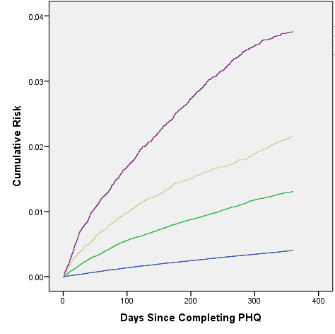
Risk of suicidal behavior following PHQ9
Suicide attempt
Suicide death
Simon, G. E., et al. (2016). Risk of suicide attempt and suicide death following completion of the patient health questionnaire depression module in community practice. J Clin Psychiatry 77(2): 221-227.

Slide 57
Summary and conclusions
Retrospective cohort studies must be constructed with care just like prospective studies
Having access to lots of data can make it easy to say: let’s just to a sensitivity analyses
Keep track and check back before you finalize analyses
When conduct a lot of analyses, interpreting results can be troublesome
Threats to validity in all studies
Rigorous studies use both design and analytic strategies to address bias
Targeted sensitivity analyses can strengthen study results and address concerns
Sometimes no right answer exists

Slide 58
Statistical methods for pragmatic trials Using real-world data to improve clinical care
Jennifer F. Bobb | May 14, 2024

Slide 59
Outline
Pragmatic Clinical Trials
Kaiser Permanente Washington Health Research Institute
Why pragmatic clinical trials (PCTs)?
Challenges in translating evidence from conventional trials to real world practice
What are pragmatic trials?
Design and analytic considerations
Common trial designs: cluster randomized, stepped wedge, Zelen
Using electronic health record (EHR) data to define eligibility criteria and for outcome ascertainment
Health equity
Case studies
PROUD Trial: parallel group cluster randomized pragmatic trial
SPARC Trial: stepped wedge pragmatic trial
MICARE Trial: Zelen trial

Slide 60

Clinical research is slow
Traditional randomized controlled trials are slow and expensive—and don’t always produce findings that are easily put into practice
In fact, it takes an average of 17 years before research findings lead to widespread changes in care
How pragmatic clinical trials can improve practice & policy
Slides adapted from NIH Collaboratory

Slide 61
Clinical research is not always directly relevant to practice
Traditional randomized trials study efficacy of treatments for carefully selected populations under ideal conditions
Difficult to translate to real world
Patients rarely meet the exact (often strict) inclusion criteria
Certain populations have often been excluded
Real-life adherence is rarely the same as treatment protocols in trials
When implemented into everyday clinical practice, often see a “voltage drop”— dramatic decrease in effectiveness
“If we want more evidence-based practice, we need more practice-based evidence.”
Green, LW. American Journal of Public Health, 2006.
How pragmatic clinical trials can improve practice & policy
Slides adapted from NIH Collaboratory

Slide 62

What are pragmatic clinical trials (PCTs)?
“Pragmatic clinical trials are performed in real-world clinical settings with highly generalizable populations to generate actionable clinical evidence at a fraction of the typical cost and time needed to conduct a traditional clinical trial.”
Advantages
Challenges
Large sample sizes
Opportunity to study a diverse population including subgroups (e.g., youth, pregnant women) that are often excluded from explanatory trials
Generalizability
Cost (per patient) – but depends on existing infrastructure
Rely on big, often messy clinical and claims data not collected for research purposes
Often randomized at a cluster level
May have a small number of clusters; correlation of participants from same cluster
Some design decisions are outside of the investigators’ control
Notes:
Also important to note that when planning a pragmatic trial, you need different infrastructure and personnel. A research program and people who do in-person data collection can’t just transition to EHR-based studies that need a lot of programmer time and expertise

Slide 63
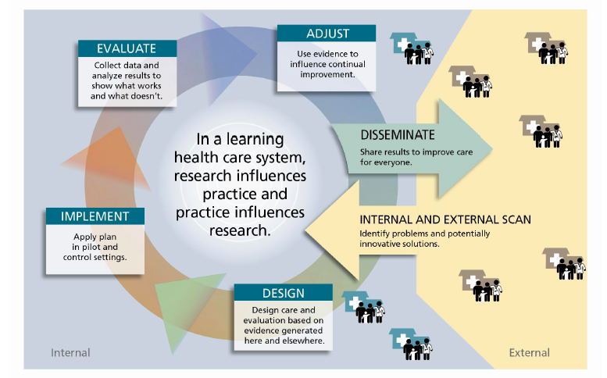
Learning Healthcare System
Notes:
Greene SM, Reid RJ, Larson EB. Implementing the learning health system: from concept to action. Ann Intern Med. 2012 Aug 7;157(3):207-10. doi: 10.7326/0003-4819-157-3-201208070-00012. PMID: 22868839.

Slide 64
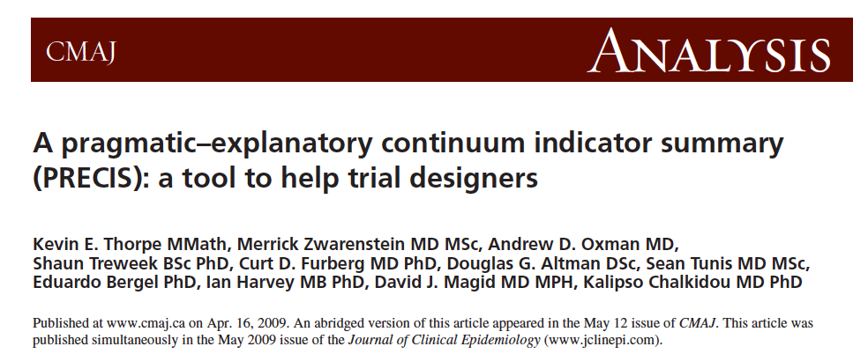
Pragmatic vs. Explanatory Trials
Pragmatic trials: ‘‘Does this intervention work under usual conditions?’’
Explanatory trials: ‘‘Can this intervention work under ideal conditions?’’
https://www.precis-2.org/

Slide 65
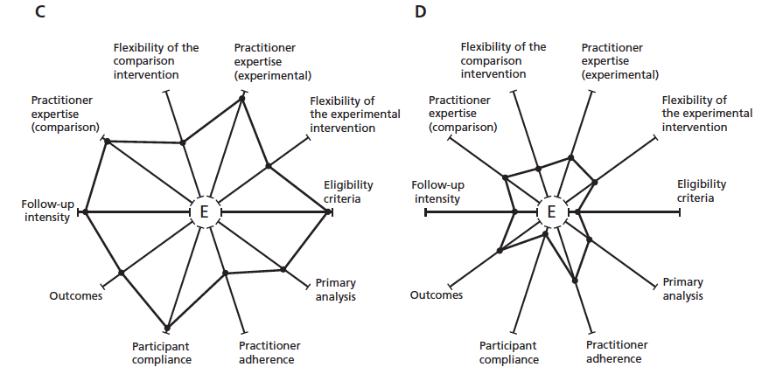
Pragmatic vs. Explanatory Trials
Notes:
10 domains

Slide 66
Pragmatic vs. Explanatory Trials
Examples of key differences:
Domain | Pragmatic Trial | Explanatory Trial
Participant eligibility criteria | All participants with condition of interest are enrolled regardless of anticipated risk, responsiveness, co-morbidities, or past compliance | Individuals at highest risk of unfavorable outcomes, expected to be highly responsive to the experimental intervention, with high compliance in pre-trial activities

Slide 67
Pragmatic vs. Explanatory Trials
Domain | Pragmatic Trial | Explanatory Trial
Experimental intervention flexibility | Highly flexible Practitioners have considerable leeway in how to formulate and apply it | Inflexible experimental intervention Strict instructions for every element

Slide 68
Pragmatic vs. Explanatory Trials
Domain | Pragmatic Trial | Explanatory Trial
Comparison intervention | ‘‘Usual practice’’ Or the best available alternative management strategy Practitioners have considerable leeway in deciding how to apply it | Restricted flexibility May use a placebo rather than the best alternative management strategy

Slide 69
Pragmatic vs. Explanatory Trials
Domain | Pragmatic Trial | Explanatory Trial
Primary trial outcome | Objectively measured Clinically meaningful to study participants Does not rely on central adjudication and can be assessed under usual conditions | Outcome is known to be a direct and immediate consequence of the intervention Often clinically meaningful, but may sometimes be a surrogate marker of another downstream outcome May require specialized training or testing not normally used to determine outcome status

Slide 70
Key features of most pragmatic trials
Use of electronic health records (EHRs)
EHRs allow efficient and cost-effective, recruitment, participant communication & monitoring, data collection, and follow up
Randomization at clinic or provider level
Protocols can be tailored to local sites and can adapt to changes in a dynamic health care environment
How pragmatic clinical trials can improve practice & policy
Slide borrowed from NIH Collaboratory

Slide 71
Outline
Pragmatic Clinical Trials
Kaiser Permanente Washington Health Research Institute
Why pragmatic clinical trials?
Challenges in translating evidence from conventional trials to real world practice
What are pragmatic trials?
Design and analytic considerations
Common trial designs: cluster randomized, stepped wedge, Zelen
Using EHR data to define eligibility criteria and for outcome ascertainment
Health equity
Case studies
PROUD Trial: parallel group cluster randomized pragmatic trial
SPARC Trial: stepped wedge pragmatic trial
MICARE Trial: Zelen trial

Slide 72
Study design
Studies embedded within health care systems must balance:
Researcher’s desire to control all aspects of the design to maintain rigor
Health system’s need to deliver efficient, high-quality care to everyone (SPARC case study)
Common study design: cluster randomized trial
Instead of randomizing individual patients, clusters of patients are randomized
Intervention may be at the cluster-level (e.g., provider trainings)
May be necessary to avoid contamination
For example, if providers are trained to provide the intervention to patients, and they have some patients randomized to the intervention and some randomized to control, it may be challenging to avoid contamination between the intervention arms
Contamination leads to diluted intervention effects
Patients in the same cluster are correlated → needs to be accounted for in the analysis

Slide 73
Cluster randomized trials
May not be able to avoid contamination completely
Patients may go to multiple providers or clinics (especially if intervention period is long)
Think about whether this is the best design
Choice of randomization unit (cluster):
Provider < Panel < Clinic < Region < Site
Goal: smallest unit without contamination
For a given sample size (# patients), statistical power increases as the number of clusters increases
More clusters are better if possible
Smaller number of clusters leads to inference challenges
Chance imbalance in covariates
Elevated type 1 error rates for individual-level analyses (generalized estimating equations [GEE], generalized linear mixed-effect models [GLMM])
Therapists
Primary Care Physicians
Psychiatrists
Patients
Notes:
Note: concerns about consent should never be a dictating factor in choosing the randomization unit

Slide 74
Randomization
Simple randomization
Stratified randomization
Stratify on a small set of covariates (note: covariate values needed prior to randomization)
Covariate-constrained randomization
Balances a large number of characteristics
Requires that all clusters are recruited prior to randomization
Example of general approach:
Enumerate all (or simulate many) cluster randomization assignments (A or B but not actual treatment)
Across these possible randomization assignments assess characteristic “balance” using a pre-specified balance metric (several options available)
Restrict to those assignments with balance (requires specifying a threshold)
Randomly choose from the “constrained” pool a randomization scheme
Randomly assign treatments to A or B
Notes:
Note: when you are trying to randomize units in real time with messy data having accurate information on baseline covariates prior to randomization is not always easy or possible

Slide 75
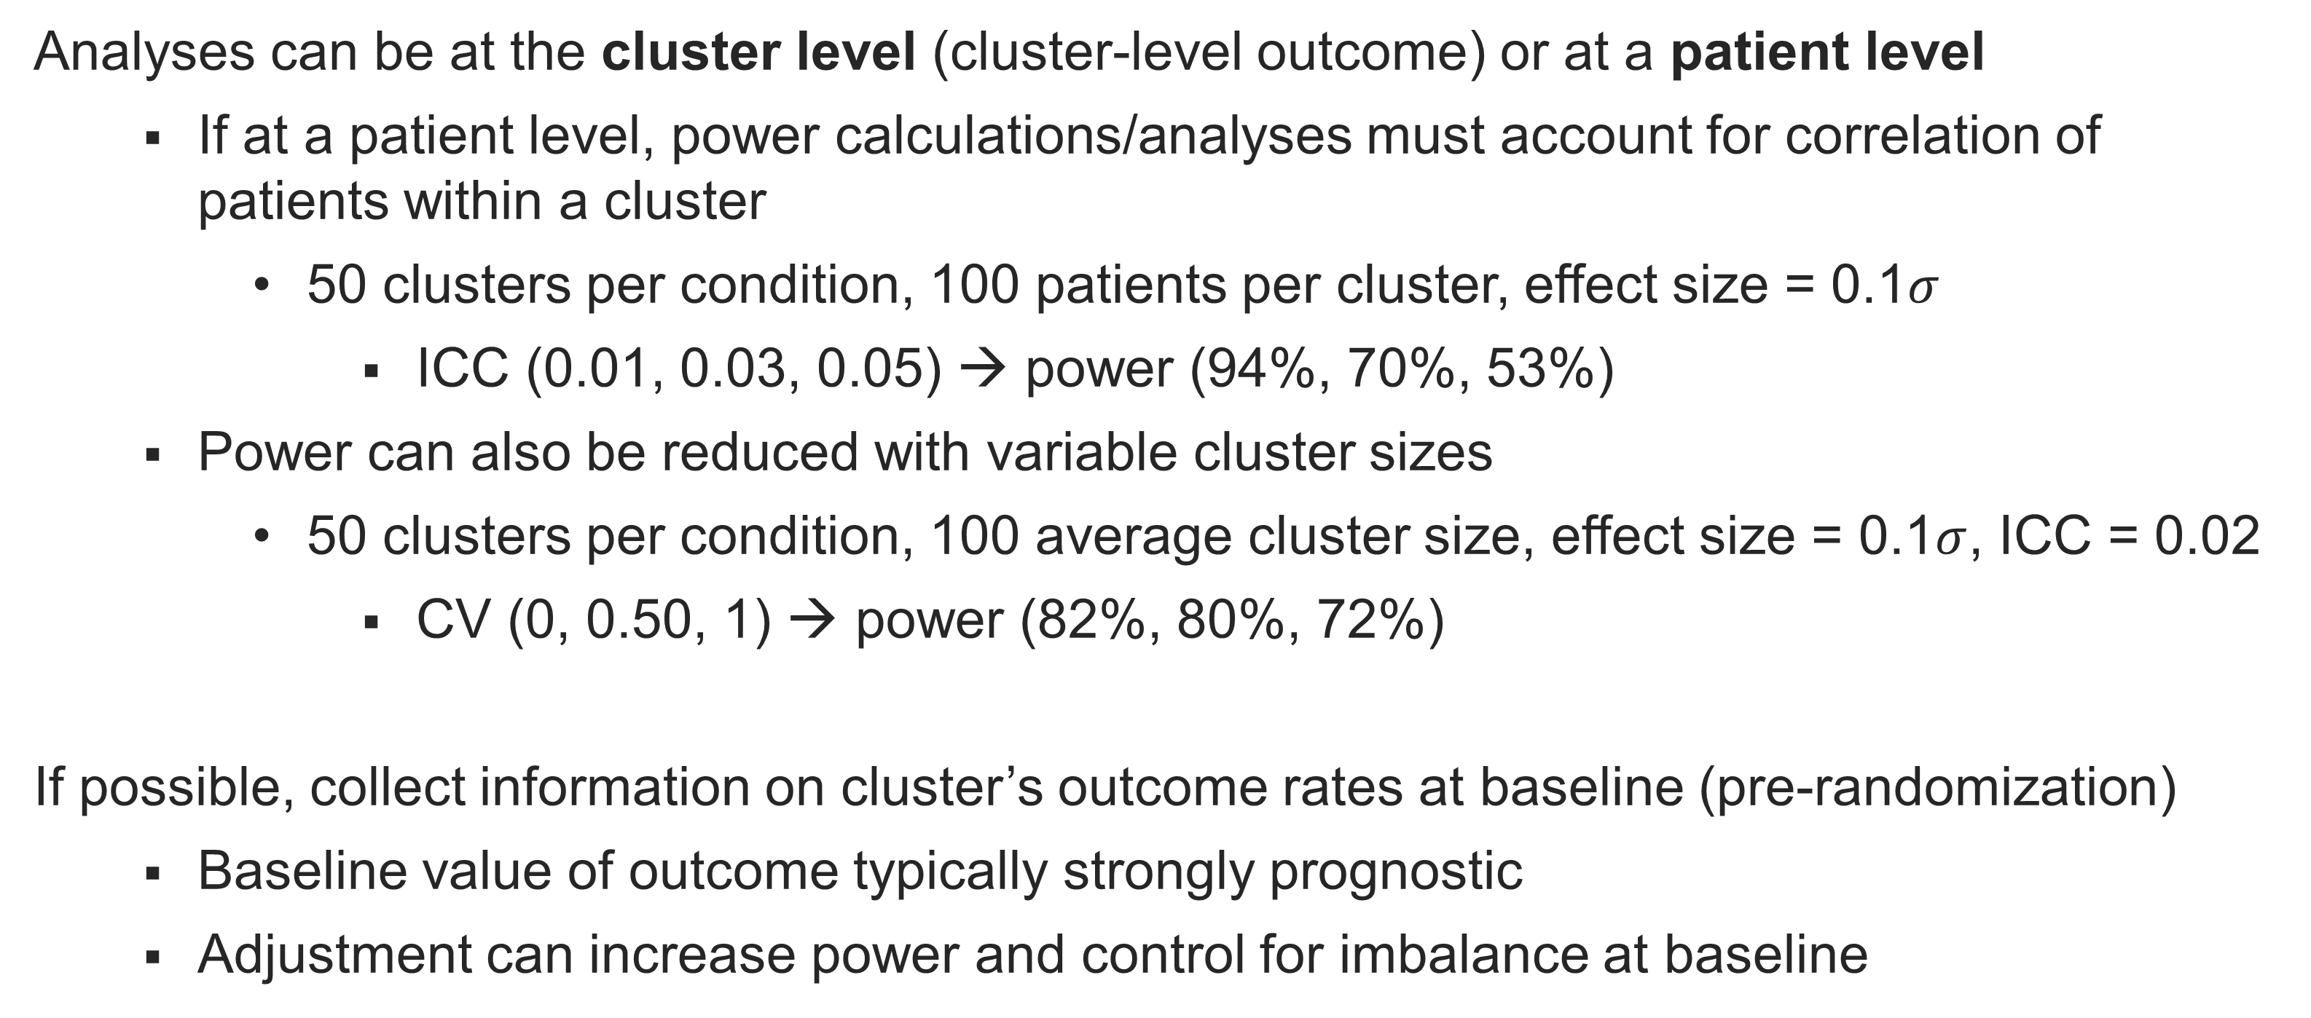
Cluster randomized trials
Analyses can be at the cluster level (cluster-level outcome) or at a patient level
If at a patient level, power calculations/analyses must account for correlation of patients within a cluster
50 clusters per condition, 100 patients per cluster, effect size = 0.1$σ$
ICC (0.01, 0.03, 0.05) → power (94%, 70%, 53%)
Power can also be reduced with variable cluster sizes
50 clusters per condition, 100 average cluster size, effect size = 0.1$σ$, ICC = 0.02
CV (0, 0.50, 1) → power (82%, 80%, 72%)
If possible, collect information on cluster’s outcome rates at baseline (pre-randomization)
Baseline value of outcome typically strongly prognostic
Adjustment can increase power and control for imbalance at baseline
Notes:
Define effect size verbally

Slide 76
Stepped wedge cluster randomized trials
All clusters receive the intervention, eventually
Randomize timing of when the cluster is turned on to intervention
Within each time point, clusters are exchangeable (i.e., expect balance in covariates)
But intervention effect confounded with time
Analysis must account potential confounding due to secular trends

Slide 77
Stepped wedge cluster randomized trials
Because of the potential for confounding, choice of the design needs to be clearly justified
Undesirable if large underlying time trends (e.g., changes in opioids prescriptions)
Pre-specify approach to account for time trends
Sensitivity analyses varying the approach
Different types of stepped wedge trials
Cross sectional: different patients measured at each time point
Closed cohort: same participants measured at each time point
Open cohort: patients enter (and leave) cohort at different time points
Common in EHR studies within health systems
Analysis should use longitudinal data methods and account for correlation of…
Patients from the same clinic (at the same or different time periods)
Repeated measures from same patient (closed or open cohort design)

Slide 78
Zelen design
Enrolled patients
R
Usual Care (not contacted)
Offered
Intervention
Zelen design / encouragement trial
Individually randomized
Instead of consent followed by randomization, randomize patients to be “offered” an intervention (a subset of whom may consent)
Primary intent-to-treat (ITT) analysis compare patients offered intervention to those who are not offered intervention (usual care)
Power calculations need to account for dilution of effect
Consent rate major driver of power
Patients randomized to usual care are never contacted
Need to be able to ascertain the outcome on everyone (including those who did not consent to the intervention and those who were randomized to usual care and never contacted)
Consent
No Consent

Slide 79
Defining eligibility criteria of sample using EHR data
In many pragmatic trials, no patient contact for research purposes
Patients may be contacted as part of the intervention but not for research
EHR (and claims) data used to ascertain eligibility criteria of sample to be analyzed
In traditional cluster randomized trials, if patients are recruited after randomization:
Intervention group assignment could affect who is recruited
Possibility for type of post-randomization selection bias called “recruitment bias”
Patients recruited in intervention clusters may be systematically different than those recruited in usual care clusters
In pragmatic cluster randomized trials without patient contact:
If patients are identified for inclusion in trial analyses using post-randomization data, potential for similar type of bias (“identification bias”)

Slide 80
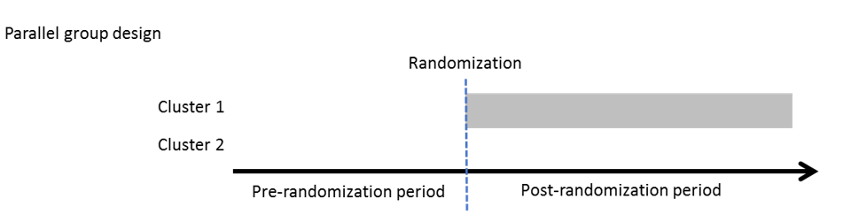
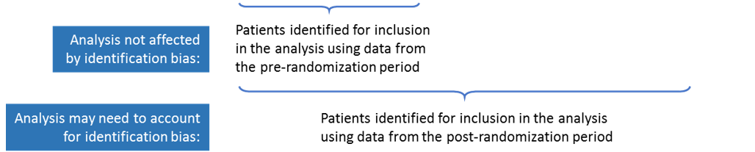
Identification bias

Slide 81
Approaches to address identification bias in cluster-randomized trials
Study design (preferred)
Primary analysis: define sample using pre-randomization data (PROUD case study)
If sample defined using post-randomization data, some samples may be less likely to be affected by treatment assignment (e.g., entire clinic population)
Statistical analysis (if sample defined using post-randomization data)
Can adjust for baseline characteristics
But recent work has highlighted that this will not fully remove bias in general
Methods being developed to address identification bias analytically within the principal stratification framework for post-treatment selection bias

Slide 82
Using real world data for outcome ascertainment
In efficacy trials, measures are typically collected at regularly spaced, pre-defined time points
With the same number of follow-up measures planned per person
In pragmatic trials using real world data, this may not be possible
Measures collected as part of routine clinical care
Likely to be variability across patients and providers
May be external incentives in health system to obtain measures at certain time points (e.g., national performance metrics)
Need to consider potential for outcome ascertainment to differ across arms, potentially leading to bias (MI-CARE case study)
Outcome data can be very messy, potentially requiring extensive cleaning (possibly chart review)
Medication data: duplicates, overlap
Utilization: missing discharge date, discharge date before admit data

Slide 83
Outcome ascertainment and missing data
If someone stays enrolled in health system - assume that if you don’t observe the outcome (e.g., medical diagnosis, hospitalization) it didn’t happen
In closed system (EHR + claims data) this is likely ok
Depends upon cost of treatment (likely to get a bill the more the treatment costs)
Do you need to validate the outcomes you do observe?
Depends on the outcome (positive predictive value [PPV], sensitivity)
Depends on the cost (two-stage design?)
Notes:
NIH Collaboratory discussion of outcome data – many studies ignore and assume correct (make sure you have a decent outcome – follow-up could be different in different interventions); could be done in the future
SPOT trial – did validation of outcomes

Slide 84
Outcome ascertainment and missing data
Handling missing outcome data (e.g., if patient leaves the health system): range of different approaches (e.g., multiple imputation, weighting), depending on
Missingness mechanism: administrative missingness (MCAR), MAR, or NMAR?
Amount of missing data: how stable is your population being studied?
Condition, the type of outcome, and population being studied
Related issue: when timing of outcome measures (assessment process) could be informative (e.g., related to factors at prior time points, possibly including outcome itself)
Bourgeoning literature on outcome-dependent observation times, also referred to as informative assessments
Notes:
NIH Collaboratory discussion of outcome data – many studies ignore and assume correct (make sure you have a decent outcome – follow-up could be different in different interventions); could be done in the future
SPOT trial – did validation of outcomes

Slide 85
Health equity in PCTs
PCTs require administrative and data resources to conduct
Low resource clinics and health systems don’t always have the resources to participate
Who is in your population?
An advantage of PCTs can be ability to enroll more diverse patient sample
Are there things your study can do to increase diversity of those enrolled?
Think about how using EHR to define eligibility criteria could impact your sample
Patients with less access to care may be excluded
Diagnosis and treatment may not be the same across all racial and ethnic groups
Notes:
If eligibility is defined using EHR data (e.g., existing diagnoses, past medications) or requires an in-person encounter, then you should think about how people who have less access to care may be excluded from the study. For example, if low income or people of a particular race are less likely to be evaluated for an inclusion diagnosis, then the people you do enroll in that study who are poor or of that race will be sicker on average. This isn’t something a PCT can necessarily fix—you have to define eligibility criteria somehow—but it’s important to understand the limitations.

Slide 86
Health equity in PCTs
Heterogeneity of treatment effect analyses
Need sufficient sample size to detect interactions
As with other EHR variables, need to understand how race and ethnicity data are captured by the health system (and changes over time)
Typically limited information on individual-level SES captured in EHR
Zip code of home address may be linked to census data
Need careful interpretation of any subgroup effects
Consider social determinants of health and institutionalized barriers
Notes:
If you do subgroup analyses for race/ethnicity, be very careful about how subgroup-effects are discussed. Don’t propose some inherent biological or genetic mechanism to explain effect modification when you don’t have any evidence of that, those types of statements reinforce the idea of racial hierarchy and blames health disparities on populations with poor outcomes. Instead, consider the role of social determinants of health and institutionalized barriers that prevent people from accessing necessary care. Here is a reference for this: https://www.healthaffairs.org/do/10.1377/hblog20200630.939347/full/

Slide 87
Outline
Pragmatic Clinical Trials
Kaiser Permanente Washington Health Research Institute
Why pragmatic clinical trials?
Challenges in translating evidence from conventional trials to real world practice
What are pragmatic trials?
Design and analytic considerations
Common trial designs: cluster randomized, stepped wedge, Zelen
Using EHR data to define eligibility criteria and for outcome ascertainment
Health equity
Case studies
PROUD Trial: parallel group cluster randomized pragmatic trial
SPARC Trial: stepped wedge pragmatic trial
MICARE Trial: Zelen trial

Slide 88
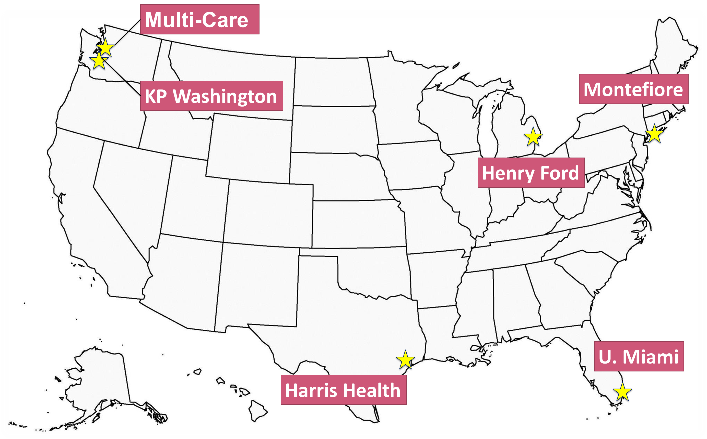
Case Study 1: The PRimary care Opioid Use Disorders Treatment (PROUD) Trial
Pragmatic, cluster-randomized implementation trial
Interventions:
Implementation of Massachusetts (MA) Model
collaborative care management for opioid use disorder (OUD)
Usual primary care
Sample: 12 primary care clinics within 6 diverse health care systems (HCS)
~375,000 PC patients
~3,300 OUD diagnosis
Randomization: stratified on the HCS (1 PROUD intervention, 1 usual primary care clinic)

Slide 89
PROUD Trial objectives
Evaluate the effectiveness of the PROUD intervention in 6 diverse health care systems:
Does intervention increase access to and retention in evidence-based treatment?
Does intervention reduce acute care utilization (emergency department and hospital care) among patients with OUD?
Outcomes assessed using EHR and other administrative health data
Aim 1:
Number of patient-years of OUD treatment (clinic-level), scaled (divided) by number of patients seen in the clinic
Aim 2:
Number of days of acute care utilization (patient-level)
Notes:
Aim 1: Implementation objective
Aim 2: Effectiveness objective
- No primary data collection, including contacting patients (quality improvement trial)

Slide 90
Challenges of the PROUD study
Challenge of PCTs: clinical and claims data not collected for research purposes
In PROUD: 2 sites are integrated health systems; 4 are not
Clinic population not well characterized: visit-based sample
Reliance on medication orders data (rather than dispensings)
Potential for incomplete ascertainment of outcomes
Approach:
Randomization stratified on the health system
Sensitivity analyses
Among 2 integrated systems
Varying approach to counting refills on orders
Notes:
Many prior PCTs have been done in integrated health systems that have complete capture of all care that is being given.
In PROUD: 2 sites are integrated health systems; 4 are not
Although the diverse set of health systems is a major strength, it leads to several methodological challenges.
Considerations of these issues motivated the decision to stratify randomization on the health system,
so that differences in ascertainment are expected to be balanced across intervention arms.

Slide 91
Challenges of the PROUD study
Challenge of PCTs: may have a small number of clusters
In PROUD: only 12 clinics (6 per arm)
Concerned about potential for chance imbalance in clinic size, other covariates
Approach:
Primary outcome is scaled clinic-level measure (divided by number of patients seen)
Patient-years of OUD treatment per 10,000 PC patients
Considered using constrained randomization
Primary analysis adjusted for the baseline value of the outcome
This ended up being key – high chance imbalance in primary outcome!
Secondary analyses adjusted for additional covariates (baseline data used to select strongest predictors of baseline value of the outcome) → no predictors selected beyond baseline
Aim 1: primary outcome results
 | PROUD | Usual Care
Baseline | 6.8 | 10.6
Follow-up | 16.0 | 14.4
Mean difference | Mean difference
Unadjusted | 1.6
Adjusted | 8.2 (P = 0.002)
Notes:
At baseline: Usual Care had 50% higher outcome
two-stage approach to
(1) use baseline data to identify variables that predict the outcome (after adjustment for the “baseline” value of the outcome from an earlier time period) via lasso regression, and then
(2) include the identified variables as further adjustment variables in the main model up to a maximum of 2 degrees of freedom, in order to avoid overfitting.

Slide 92
Challenges of the PROUD study
Challenge of PCTs: may have a small number of clusters
In PROUD: only 12 clinics (6 per arm)
When fitting a mixed-effect model (analysis approach for primary and secondary outcomes), standard testing procedures can lead to elevated type 1 error rates
Alternate small-sample degree of freedom (DF) correction methods have been evaluated, but not in context of PROUD analyses (count outcome, covariate-adjusted)
Approach:
Conducted simulation studies across a range of scenarios to identify a testing approach that achieved type 1 error rates closest to the nominal level
Likelihood ratio test with “between-within” (also called “inner-outer”) denominator degree of freedom (DDF) performed best in PROUD scenario
But no one test performed best across all scenarios

Slide 93
Challenges of the PROUD study Defining eligibility criteria for analytic sample using EHR data
Latent population of individuals with OUD
OUD is under-diagnosed (Phase 1 prevalence: 0.50%)
Clinic population at baseline (pre-randomization)
OUD
Had diagnosis at baseline
Notes:
Expected prevalence of OUD: 1-4%
3. If base population must be defined pre-randomization, how can we “count” this care to the MA clinic?

Slide 94
Challenges of the PROUD study Defining eligibility criteria for analytic sample using EHR data
Latent population of individuals with OUD
OUD is under-diagnosed (Phase 1 prevalence: 0.50%)
MA Model expected to increase diagnosis
Clinic population at baseline (pre-randomization)
OUD
Had diagnosis at baseline
Diagnosed via PROUD

Slide 95
Challenges of the PROUD study Defining eligibility criteria for analytic sample using EHR data
Latent population of individuals with OUD
OUD is under-diagnosed (Phase 1 prevalence: 0.50%)
MA Model expected to increase diagnosis
MA Model attracts new people to clinic or HCS (70-90% of patients seen by nurse)
Clinic population at baseline (pre-randomization)
OUD
Had diagnosis at baseline
OUD
Diagnosed via PROUD
Attracted by intervention
Notes:
Expected prevalence of OUD: 1-4%
3. If base population must be defined pre-randomization, how can we “count” this care to the MA clinic?

Slide 96
Potential for identification bias
Identification bias: form of selection bias that can occur when the intervention affects who is identified as being eligible for inclusion in trial analyses
Aim 2 effectiveness outcome (number of days of acute care utilization):
Example analytic study population: patients with an OUD diagnosis
Intervention affects who is diagnosed with OUD
Patients diagnosed in the intervention arm are likely to be different (either sicker or healthier) than patients diagnosed in the control arm.
Bias can be in either direction
Notes:
Identification bias affects both Aims 1 and 2. Here we will focus in on how Aim 2 is affected.

Slide 97
Addressing identification bias
Design solution: only include individuals identified pre-randomization
Randomization ensures comparability across intervention groups
Primary sample for Aim 2: 1,988 patients with a visit to the 12 PROUD trial clinics pre-randomization (pre-R) and a documented OUD diagnosis pre-R
Limitations:
Misses a large number of patients potentially affected
Patients identified pre-R may not reflect broader population with OUD
Secondary sample: add patients identified post-R to the pre-R sample
Included 1,347 patients with new OUD diagnosis or new to PROUD trial clinics after randomization (post-randomization sample)
Covariate-adjusted regression allowed for separate intervention effects in the pre- and post-R samples
Adjusted for pre-specified prognostic covariates that could differ across patients identified post-randomization in the intervention versus usual care clinics

Slide 98
Acute care utilization (Aim 2) PROUD trial results
Results not published

Slide 99
Case Study 2: The Sustained Patient-centered Alcohol Related Care (SPARC) Trial
Pragmatic, stepped-wedge implementation trial
Interventions:
Integrated alcohol-related care
Screening for unhealthy alcohol use, brief alcohol counseling
Assessment, diagnosis, and treatment of alcohol use disorders (AUDs)
Usual primary care
Sample: 19 primary care (PC) sites of Kaiser Permanente Washington
~330,000 PC patients (2015-2018)
Results:
Intervention increased brief alcohol counseling (magnitude was modest)
Intervention did not increase treatment engagement, but increased intermediate outcomes (screening, new AUD diagnosis, treatment initiation)

Slide 100
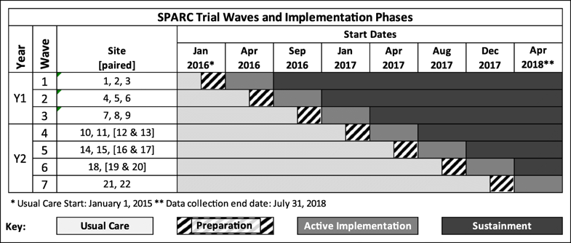
Accommodating health system needs while maintaining rigorous design and analysis
Issues: Upon funding, the delivery system committed to only the first year of the stepped-wedge trial
Approach:
Stratify randomization by year:
Year 1: Waves 1-3 (9 sites)
Year 2: Waves 4-7 (10 sites)
Analysis: adjust for stratification variable (Y1 vs. Y2 site)
Proposed sensitivity analysis allowing for interaction between time trend and stratification variable → not able to conduct due to convergence issues (rare outcome, large sample size)

Slide 101
Accommodating health system needs while maintaining rigorous design and analysis
Issues: In Year 2, 10 sites to be randomized over 4 waves (2 waves with 3 sites and 2 waves with 2 sites)
Due to practical constraints, one large site (Site A) needed to be with only one other site
By Year 2, leaders wanted as many sites to implement as soon as possible, and therefore requested that the last wave have just 2 sites
Approach:
These two constraints combined could result in Site A having a larger probability of being assigned to the last wave
Last wave contributes least amount of exposure time to intervention
To accommodate the above requests, we developed a randomization scheme to ensure that each site would have equal probability of being assigned to each wave
Notes:
In a stepped wedge trial, it is KEY for the probability of any site being in one wave to be equal across clinics. If we hadn’t thought about these constraints carefully, we would have easily failed this principle.
The delivery system can throw a lot of stuff at you, but you can still satisfy this.
This principle is especially important in this stepped wedge trial because the last wave contributed the least data.
[ we could have resulted in a randomization where site A (the pair) had a 0.5 probability of being assigned to Wave 7 and whereas the other sites would have had a 17% probability of being assigned to wave 7.]
Given the requirements above that the last wave have just two sites and that one Y2 site needed to be in a wave with just one other site (we will refer to this site as site A), we developed a randomization scheme to ensure that each site had the same probability of being assigned to each wave (0.2 probability to be assigned to Y2 wave 4 and 0.8/3 each for waves 1-3 of Y2) as follows. First, we randomly selected one of the first 3 waves to be the other 2-site wave. Then, we randomly assigned site A to wave 4 with probability 0.2 or to the other 2-site wave with probability 0.8. The remaining 9 Y2 sites were then to be randomly assigned to the other available slots. Under this randomization scheme, letting B denote an arbitrary site different from site A, we have:
P(site A assigned to wave 4) = 0.2
P(site B assigned to wave 4) = P(site B assigned to wave 4 | A assigned to wave 4) * P(A assigned to wave 4) + P(site B assigned to wave 4 | A not assigned to wave 4) = 1/9*0.2 + 2/9*0.8 = 0.2
P(site A assigned to wave j) = P(wave j assigned to be the other 2-site wave) * P(site A assigned to wave j | wave j assigned to be the other 2-site wave) = 1/3*0.8, for j = 1,2,3
P(site B assigned to wave j) = 1/3*[1 – P(site B assigned to wave 4)] = 0.8/3, for j = 1,2,3

Slide 102
Case Study 3: More Individualized Care: Assessment and Recovery through Engagement (MICARE) Trial
Pragmatic, individually-randomized Zelen trial
Interventions:
Telephone-based nurse care management for depression and OUD
Usual primary care
Sample: Target of 800 patients within 2 health systems
Randomization: within each health system, 1:1 randomization to be offered the intervention vs. usual care (usual care patients not contacted)
Aims: Test whether offering the intervention:
Increases sustained OUD medication treatment (primary outcome)
Reduces depressive symptoms on PHQ-9 (depression screen collected as part of routine care)

Slide 103
Challenges of the MICARE study
Challenge: using clinical measures from the EHR as trial outcomes
In MI-CARE: for depression outcomes, need to consider
Irregular timing of measures not controlled by study team
Repeated measures over follow-up window
Differential administration of measures across arms
Depression outcome measures:
Continuous: change in PHQ-9 score from baseline to follow-up
Binary: depression resolution (50% reduction from baseline score)
Approach: Baseline data used to inform statistical design to address these challenges
Notes:
two-stage approach to
(1) use baseline data to identify variables that predict the outcome (after adjustment for the “baseline” value of the outcome from an earlier time period) via lasso regression, and then
(2) include the identified variables as further adjustment variables in the main model up to a maximum of 2 degrees of freedom, in order to avoid overfitting.

Slide 104
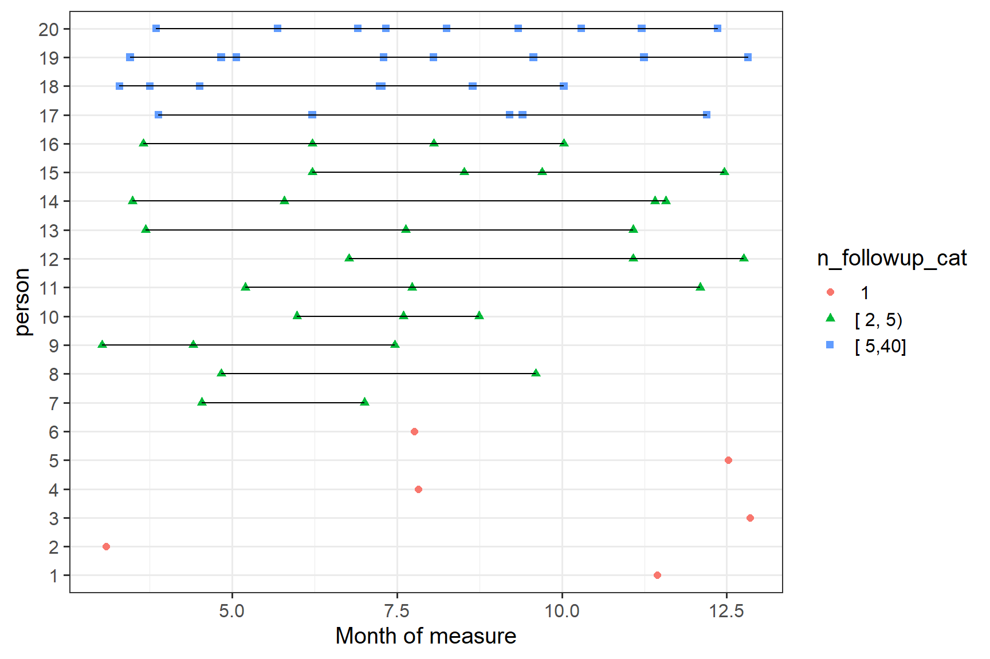
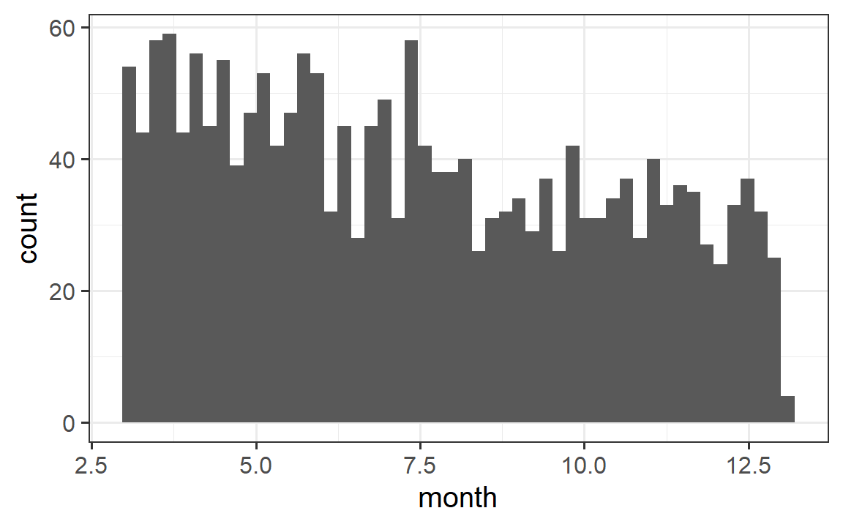
Challenges of the MICARE study Follow-up PHQ-9 scores not controlled by study team
Time from “index” score until follow-up
Irregularly spaced measures
Repeated measures: among those with ≥1 measure
35% with single measure,
25% with ≥5 measures
Notes:
two-stage approach to
(1) use baseline data to identify variables that predict the outcome (after adjustment for the “baseline” value of the outcome from an earlier time period) via lasso regression, and then
(2) include the identified variables as further adjustment variables in the main model up to a maximum of 2 degrees of freedom, in order to avoid overfitting.

Slide 105
Challenges of the MICARE study Differential administration of measures across arms
Intervention may alter the frequency and timing of the outcome measure
In MI-CARE, intervention expected to increase follow up
Nurse care manager follows up ~weekly and decreases to monthly once patients are stable (though in reality, follow up is also driven by the patient)
In contrast, follow up in usual care less regular for many patients
We refer to this problem as “intervention-dependent observation process”

Slide 106
Informing statistical study design using baseline data
Design decision: selecting a time window for outcome ascertainment
Given irregular distribution of follow-up measures over time
Original plan: use follow-up PHQ-9 score during 4-12 months after randomization
assumed 60% of patients would have a follow-up score
Exploration to examine assumption: constructed retrospective cohort using baseline data
“follow-up” rates were 57.7% and 50.6% in the two sites, at 4-12 months
Examined how alternate time windows affected follow up
Extending window increases follow up; tradeoff with decreasing time for data cleaning and trial analyses
Also need to consider whether time windows are clinically meaningful
Final plan: use 3-13 month window: rates 71.1% and 57.8%

Slide 107
Informing statistical study design using baseline data Selecting which follow-up measure(s) to use in setting of intervention-depending observations
Design decision: selecting which follow-up measure(s) to use
Given that many patients have repeated measures during the window
Goal: maximize power while avoiding bias due to intervention-dependent observation process
Considerations:
Using “best score” over follow-up could lead to high levels of bias
Investigators hypothesized that the intervention impact would increase over the course of the 12-month intervention period as more patients engage with the NCM
Initial proposal for analytic approach: linear regression using follow-up score closest to 12 months (end of intervention period), adjusted for time since baseline
Exploration to examine approach: Using a simulation study, evaluated whether proposed approach is unbiased or whether there may be more powerful analytic approaches
Final approach specified in the standalone statistical analysis plan (SAP) for the trial

Slide 108
Informing statistical study design using baseline data Selecting which follow-up measure(s) to use in setting of intervention-depending observations
Findings: initial approach using score closest to 12 months unbiased, provided adjustment for time since baseline sufficiently flexible
However, in presence of time-varying intervention effect, estimand is a weighted treatment effect, not effect at 12 months
Weights somewhat hard to interpret (related to overlap in observation times between arms)
Models allowing for a time-varying effect and adjust for baseline do estimate the effect at 12 months
Using a linear mixed model (LMM) using all follow-up scores within the 3-13 month window and allowing for a flexible correlation structure, given irregularly space follow-up times, achieved highest power across the scenarios considered
Updated approach: use LMM including all follow-up scores, adjusting for time since baseline and allowing for a time-varying intervention effect (flexibly via splines)
From model, estimate effect at 12 months

Slide 109
Case study conclusions
Many challenges of studies using real-world data (like EHRs) can be addressed with thoughtful study design
Stratified randomization, sample definition, outcome identification
Defining the eligibility criteria for the sample to be analyzed requires careful thought
Clinical measures from EHR have several challenges when used as trial outcomes
Without careful consideration, differential ascertainment of outcomes across study arms could lead to biased estimates of intervention effects
Preliminary data (prior to randomization) can be used to examine assumptions and inform the study design
Allow ample time for protocol refinement prior to study launch
Some aspects of the analysis can be further refined as the statistical analysis plan (SAP) is developed

Slide 110
Summary
PCTs enable studying interventions in real world clinical settings and inform learning health systems
PCTs add complication
First question: can this question be answered using a pragmatic trial approach?
Using EHR data is valuable, but understanding the performance of all measures is important
Appropriate analysis considering design, randomization, and outcome ascertainment is key
Health equity: consider who is in your sample and whether the intervention effect may differ across populations
Ongoing area of active research: many open design and statistical questions

Slide 111
Thank you! Questions?
Acknowledgments
General slides on pragmatic trials adapted from Andrea Cook and the NIH Collaboratory
Examples used in slides come from studies funded by
National Institutes of Health
NIDA Clinical Trials Network and NIMH
Agency for Healthcare Research and Quality (AHRQ)
A special thank you to the principal investigators, scientists, and statisticians on these studies, including:
Katharine Bradley, Lynn DeBar, Melissa Anderson, Hongxiang Qiu, Onchee Yu, Abisola Idu, Jennifer McCormack, Abigail Matthews

Slide 112
Statistical methods for electronic health record data American Causal Inference Conference
Discussion
Jennifer F Bobb, R Yates Coley, Susan M Shortreed
Biostatistics Unit, Kaiser Permanente Washington Health Research Institute (KPWHRI)
jennifer.f.bobb@kp.org, rebecca.y.coley@kp.org, susan.m.shortreed@kp.org
Acknowledgements to entire Biostatistics Unit at KPWHRI, funders, and collaborators
Notes:
Focus on design and analysis, not focusing on code

